Slide 1
NYPD Crime Analysis -Python Project
Team Vegan – Kasawn L, Patrick B, Swetha V, Pam C

Slide 2
Project Work
NYPD crime data analysis – Pam C
NY education data analysis – Swetha V
NY income , unemployment data analysis – Patrick B
Graph analysis – Kasawn L
Libraries used- numpy, pandas, matplotlib, census, uszipcode, BeautifulSoup, gmaps, requests, json, and time

Slide 3
Team Objectives
What are the central causes of crime in NYC?
Differences in crime that exist between NY boroughs.
A mapping of top 5 felony crimes & crime hours per borough.
How does education/high school dropout rate in a particular borough impact its crime rate.
How does median income/unemployment rates in a particular borough impact its crime rate
Heat maps that shows concentration of crimes across boroughs, areas that has higher percentage of school drop outs etc
Scatter plots and linear regression of different factors vs. felonies in an area of NYC

Slide 4
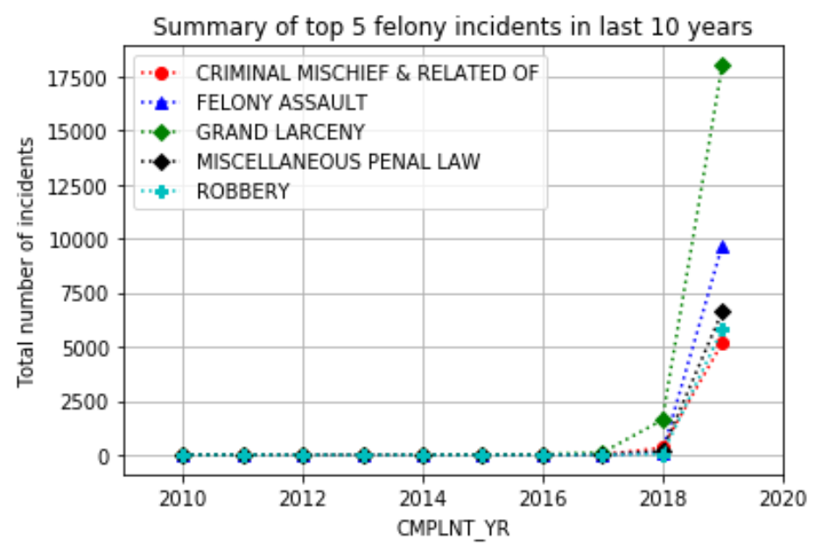
NYPD crime data analysis
Data Source :
Open data source NYPD complaint data was used for crime analysis (222,398 records in file).
Data Selection & Cleaning Process :
Analyzed data for “Felony” crime , which is the top crime classification amongst the three (Felony, Misdemeanor , Violation)
Drop records where “complaint date” not registered , replace Nan with 0 to enable aggregations on req cols.
Analyzed data for last 10 years (2010 – 2019) , and top 5 offense categories under Felony (47,755 records for analysis)
Our data is almost entirely comprised of 2018-19 crimes
Summary of top 5 felony incidents in last 10 years:

Slide 5
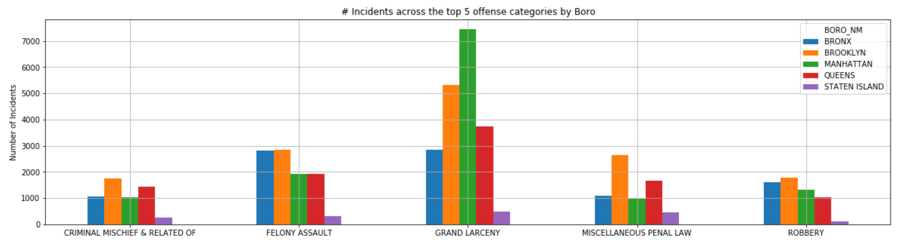
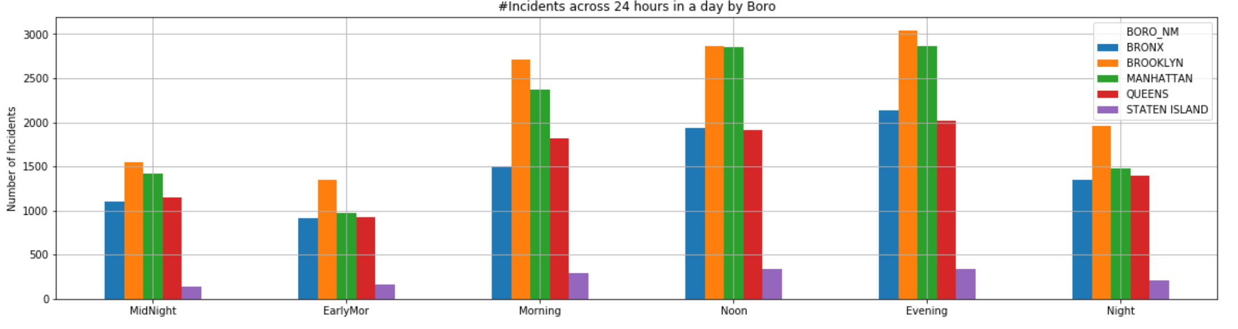
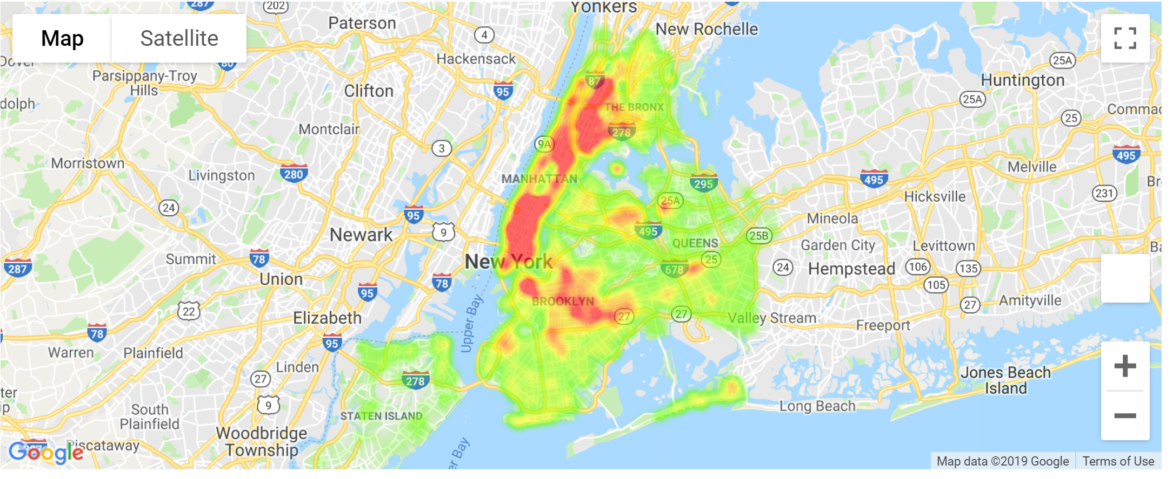
NYPD crime data analysis-cont’d
Multi plot bar charts - top 5 offense cat and # incidents at various times by Boro
“Grand Larceny” is the highest reported felony offense crime in the last 10 years.
Except for “Grand Larceny” being highest in Manhattan ( also noted in the heat map), Brooklyn on average has the highest crimes reported for all other categories.
Staten Island on the other hand has the least number of crimes reported across all categories, but it also has lower population ( <500k) compared to Brooklyn(2.5M) , Queens(2.4M), Manhattan(1.6M) and Bronx(1.4M).
More number of crimes have occurred at noon and evening times.
Heat Map – concentration of crimes across Boro’s

Slide 6
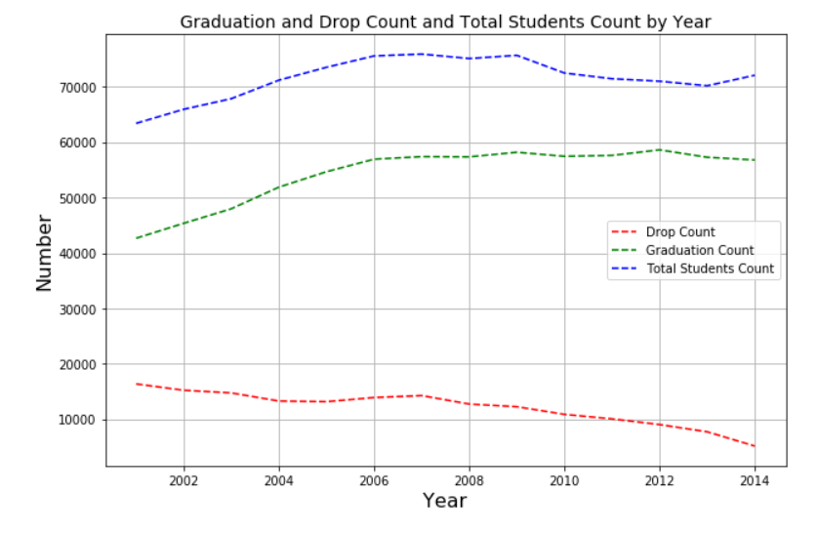
NYC HS Graduation data analysis
Data Source :
NYC Open Data was used to download Graduation Outcome from 2001-2014 (24034 records in file). https://www.kaggle.com/nycopendata/high-schools
Data Selection & Cleaning Process :
Data involved Graduation and dropout number and percentage of Cohort. Clean up data to show the last row of each Cohort year.
NYC school directory was downloaded to lookup latitude and longitude for each school.
Only data till Cohort year 2014 existed since the cohort of 2015 is going to graduate in 2019 June and Aug but data was unavailable
Summary:
Data shows overall student count has been steady since 2004 but the number of dropouts has been decreasing.
Summary of Graduation and Drop out count in the last 14 years:

Slide 7
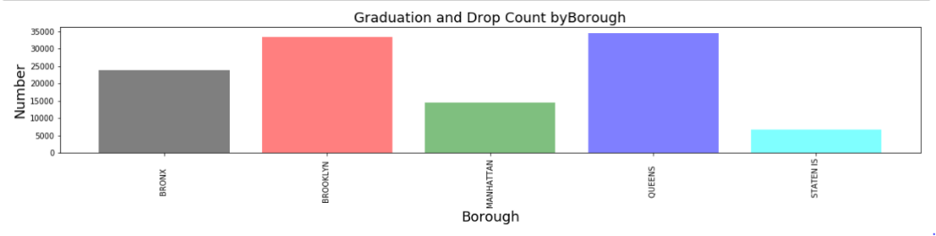
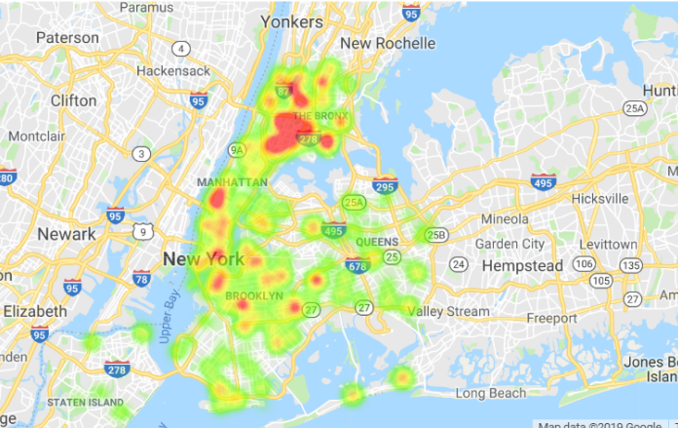
NYC HS Graduation data analysis
Multi plot bar charts – Dropout rate out of total students in Cohort(All Years)
Both Heat map and bar plot show the highest number of dropout rates in each borough.
Bronx has the highest percentage dropout but if we observer the highest dropout count queens and Brooklyn are among the top.
Hence drop out rate is a good indication since it accounts for total student population in each area and number of students dropping out.
Drop out Count by Borough
Heat Map – Dropout rate by Borough

Slide 8
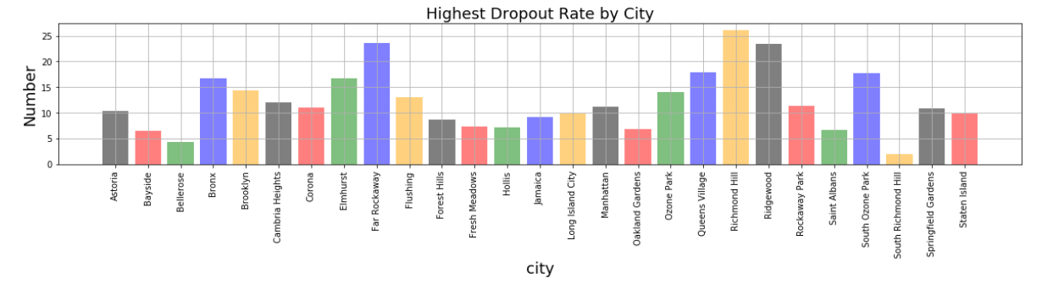
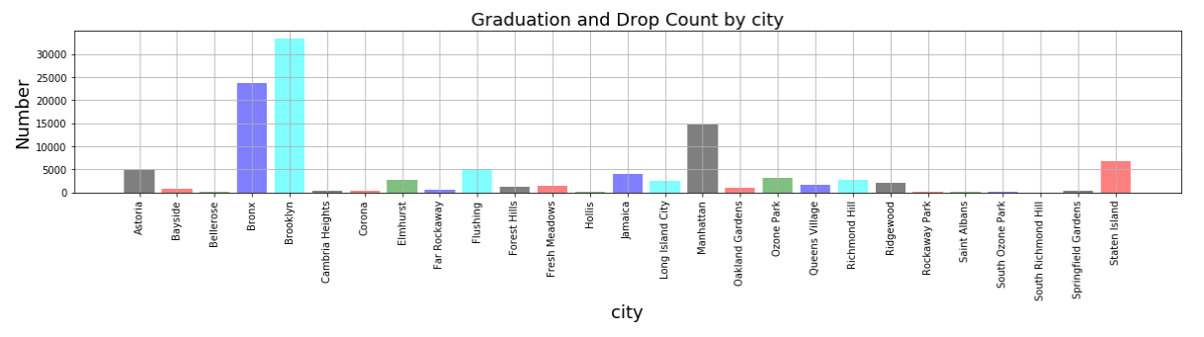
NYC HS Graduation data analysis
Multi plot bar charts – Drop out rate out of total students in Cohort(All Years)
We also looked at drop out rate and count by city and Bronx and Brooklyn stand among the top.
Dropping out of school does not automatically result in a life of crime, but high school dropouts are far more likely than high school graduates to be arrested.
If we disregard Manhattan and due to the large amount of population Brooklyn and Bronx are among the highest dropout rates and also showing significant crime rates.
Drop out rate by City
Percentage
Drop out Count by City

Slide 9
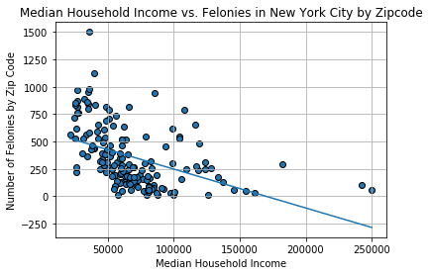
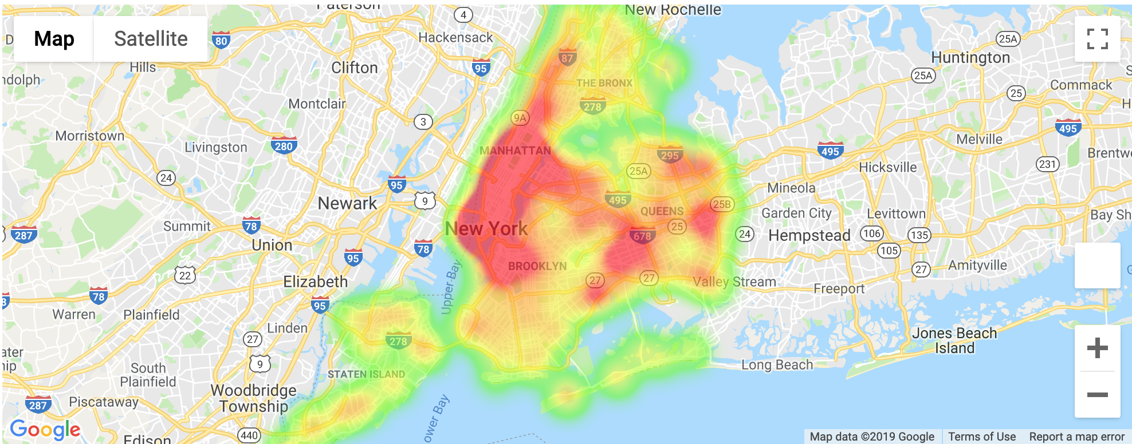
Median Household Income
Data Source- US ACS 2018 and IncomebyZipCode.com
R^2 = 0.20661131

Slide 10
Felony Crime vs. Median Income

Slide 11
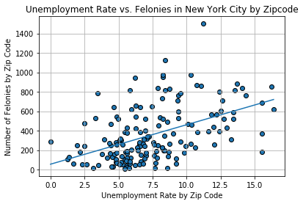
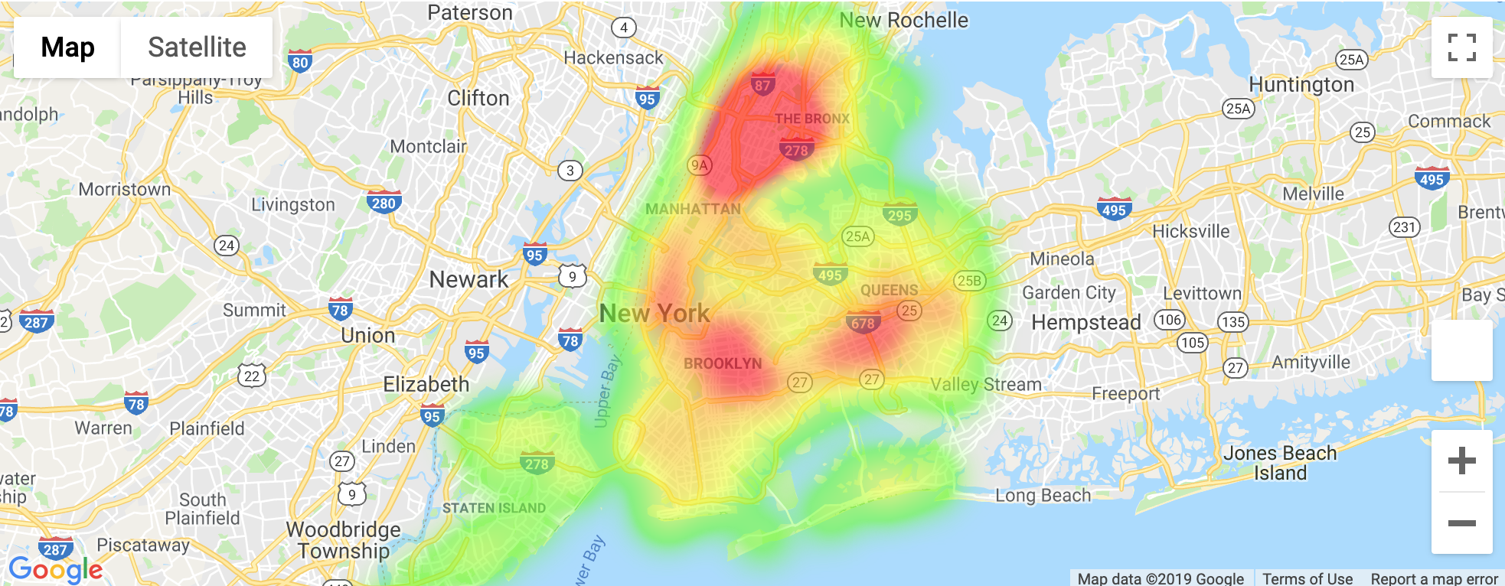
Unemployment Rate
Data Source- US ACS 2018
R^2 = 0.22597

Slide 12
Felony Crime vs. Unemployment Rate

Slide 13
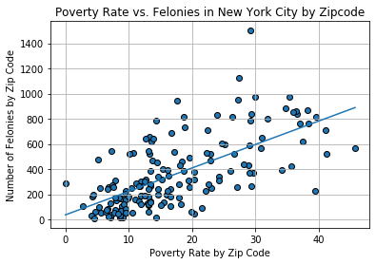
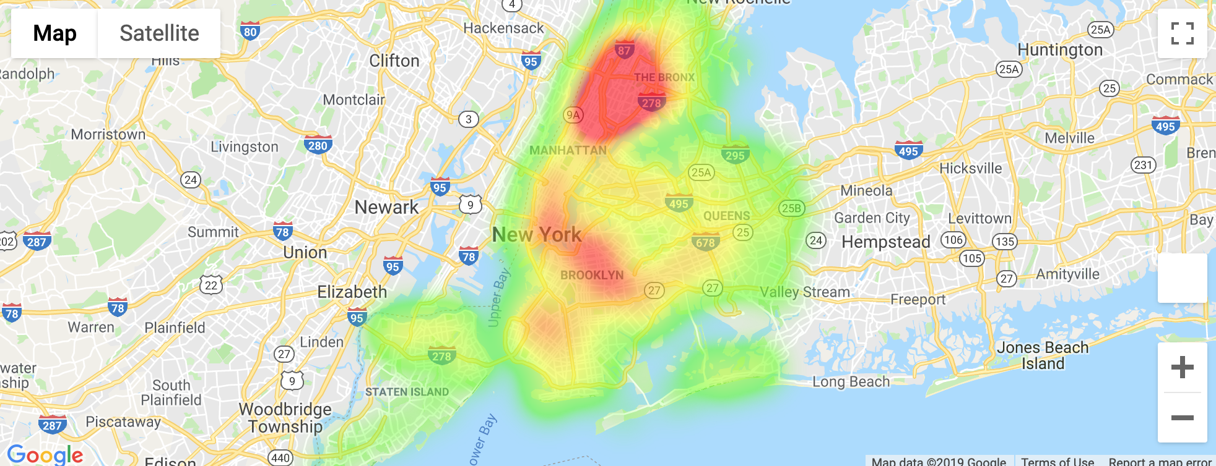
Poverty Rate
Data Source- US ACS 2018
R^2 = 0.43650774

Slide 14
Felony Crime vs. Poverty Rate

Slide 15
Next Steps and Limitations
Consider different factors of the causes of crime in NYC with the hope of finding higher correlations
Conduct linear regression analysis on our new factors with the hope of finding higher R^2
Conduct multivariate regression analysis

